Slide 1
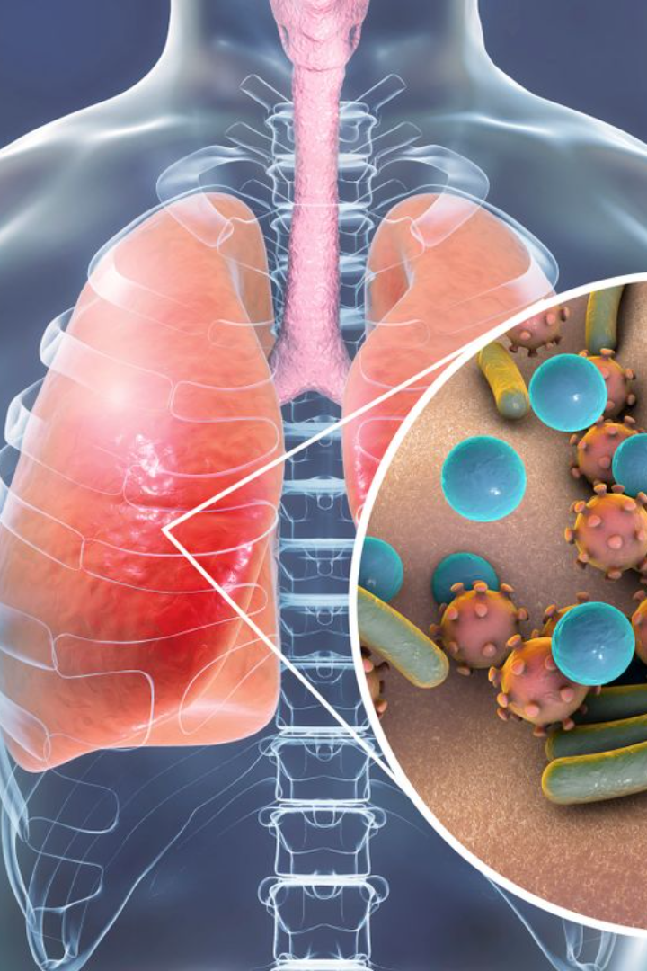
Detection of Pneumonia using Convolutional Neural Networks in Deep Learning
VALLAMBHOTLA SANTOSH KUMAR (20471A4358)
SHAIK NADEEM (21475A4304)
MADASU SRIRAM (20471A4331)
THOTA SAI VAMSI (21475A4301)
PROJECT GUIDE:
M. RAMAKRISHNA REDDY M.Tech Asst.Professor

Slide 2
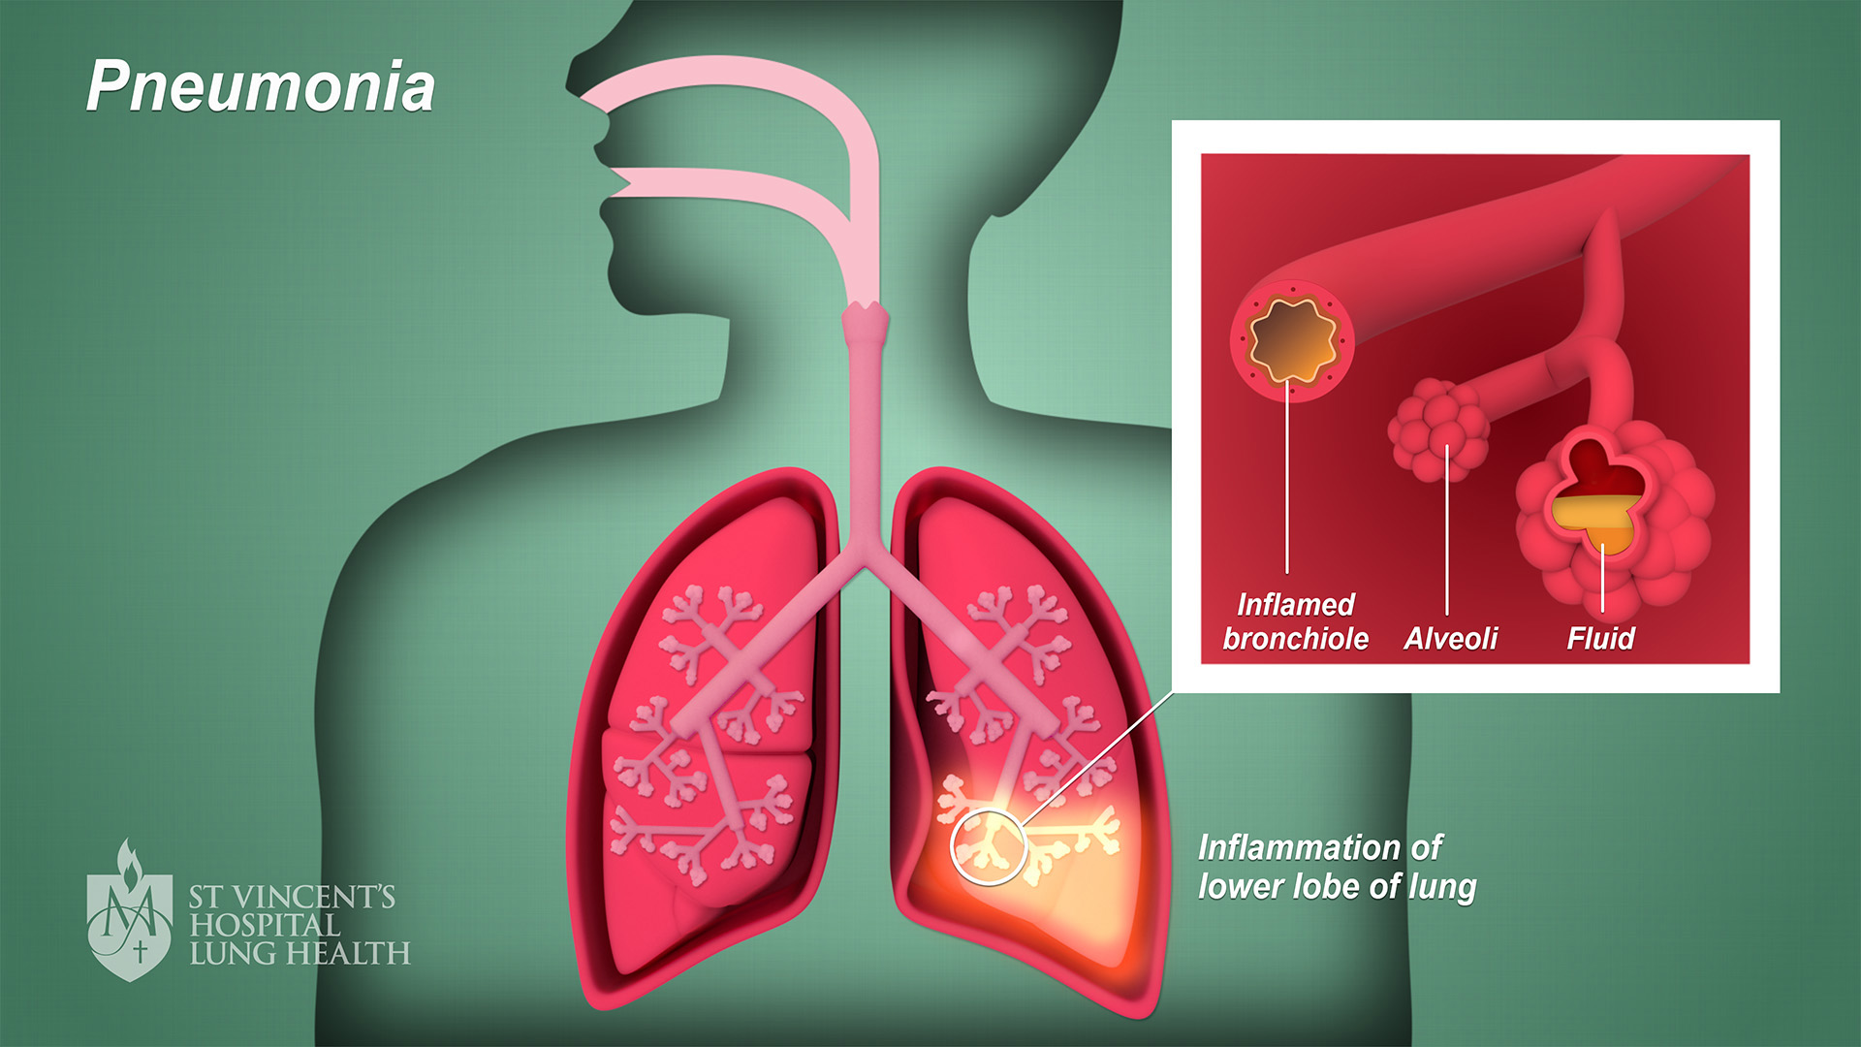
Outline
Introduction
Objective and motivation
Abstract
Flow chart
Techniques
Conclusion

Slide 3

Introduction
computer vision is an important area of artificial intelligence (AI) application as it provides answers to a wide range of issues that people encounter in the twenty-first century. AI-assisted medical picture diagnosis is one of the computer vision domains that has consistently shown promise.
Pneumonia is a leading cause of death, accounting for more than 4 million deaths annually. There are numerous types of pneumonia; it can be bacterial, fungal, or viral, and each of these types can belong to a different class. Chest X-rays (CXR) and computed tomography (CT) scans are the two most often used methods for diagnosing pneumonia; the former is more widely available and less expensive worldwide.
Therefore, creating an autonomous system to identify pneumonia might be beneficial for promptly treating the illness, especially in isolated locations. Convolutional Neural Networks (CNNs) have garnered significant interest in the field of sickness categorization as a result of deep learning algorithms' remarkable performance in assessing medical imaging.

Slide 4
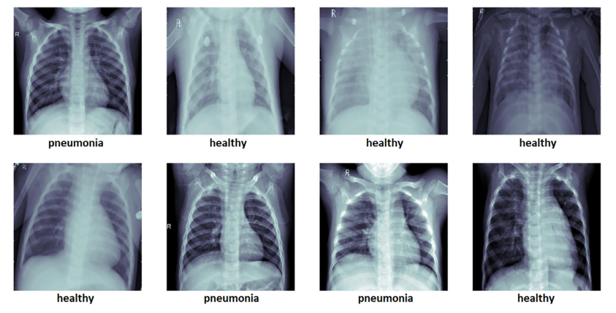

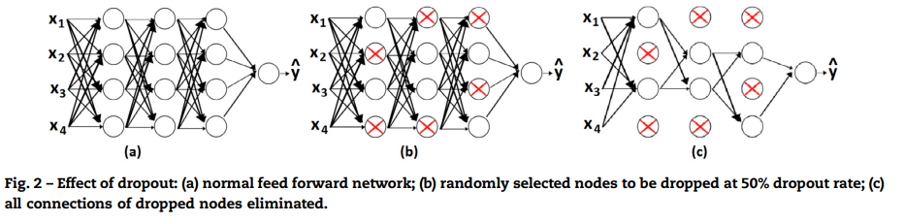
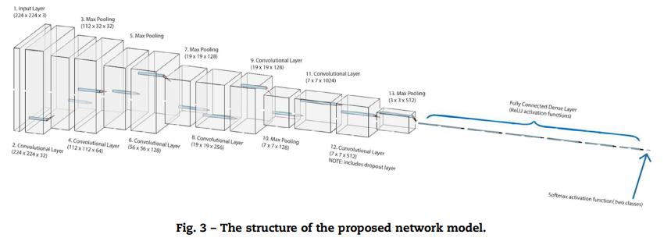
Objective and motivation
This study's dataset comes from one of Kaggle's many deep learning competitions. The collection includes lung X-ray pictures of newborns from one to five years old. Medical professionals confirmed the X-ray pictures from Guangzhou Women and Children's Medical Center. Every chest X-ray was taken as a standard clinical procedure for the patients. Of the 5856 annotated photos in the dataset, 4273 displayed pneumonia, while the remaining 1583 were negatives. In this work, we propose to build a convolutional neural network without the need of pretrained weights or transfer learning. Our network uses a dropout layer that is carefully placed in the convolutional component of the network, in contrast to most CNN architectures published in the literature. This location of the dropout layer deviates significantly from the conventional practice of placing dropout layers only in the fully connected dense part of the network. The images supplied to the network modules are RGB images that have been previously downsized to the following dimensions: 224 × 224 ˗ 3. To speed up and improve the efficiency of the computations, the resized images are normalized by dividing each of the pixel values across the three channels by 255.

Slide 5
Abstract
Humans can get pneumonia, a potentially deadly bacterial infection of one or both lungs, from Streptococcus pneumoniae. When it comes to children under five, pneumonia is the leading cause of death due to interstitial lung disease. It killed almost 880,000 children in 2021, or roughly 16% of all child fatalities under the age of five, according to a UNICEF report.
In order to effectively diagnose and treat pneumonia in patients, this study offers convolutional neural network models for identifying pneumonic lungs from chest X-rays.
Because the symptoms of pneumonia are not often visible on CT or X-ray scans, objective and automated diagnosis of the condition poses a significant problem in medical imaging. Moreover, it is a crucial duty since pneumonia claims millions of lives each year. This paper's primary objective is to offer a remedy for the aforementioned issue. employing a cutting-edge deep neural network design

Slide 6

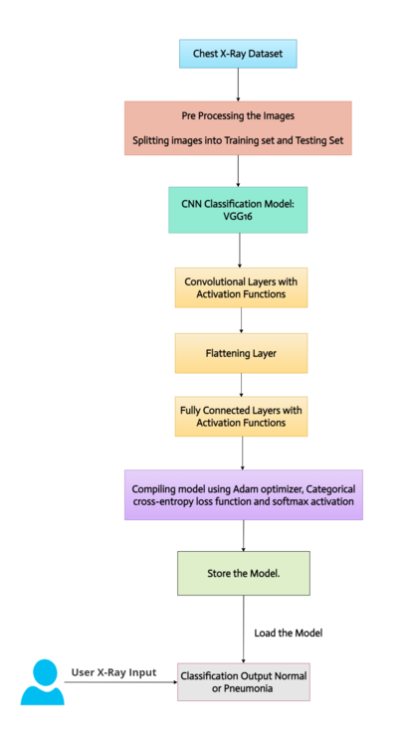
Flow chart
Our novel model bears a small resemblance to the VGG-16 design, as certain of its first layers share a structure akin to that of the convolutional layer, batch normalization layer, activation layer, and pooling layer. But our network's architecture is very different from the VGG's, whose performance on the provided dataset was subpar.
The dropout's unique integration is found in a convolutional layer, as was previously mentioned. The model exhibits a sequence of convolutional layers succeeded by pooling layers. This pattern appears again because it demonstrates the convolutional layers' strength and capacity to learn particular features, which are known as feature maps when numerous of them are layered together. In essence, filters are what allow the neural network to recognize particular patterns, such edges. Although filters can be initialized in a variety of ways, they are essentially the mechanism required for feature extraction; the convolutional layer's job is to learn the individual features during training.

Slide 7
Techniques
VGG16:
This Convolutional Neural Network (CNN) architecture is simple and widely used for ImageNet, a large visible database mission used in research on visual object detection software.
Transfer learning (TL):
This deep learning technique is centered around using a neural network that has already been trained, storing the knowledge it gains from solving a particular problem, and then applying that knowledge to new datasets.
Tensor Flow:
An open-source machine learning package called TensorFlow is used to compute numbers using data flow graphs. Artificial intelligence and machine learning are two uses for it.
Keras:
It is a Python module for deep learning that runs on the top of TensorFlow library
SciPy :
SciPy is a free and open-source Python module used for technical and scientific computing. As we require Image Transformations in this article we have to install SciPy module
GLOB:
In Python, the glob module is used to retrieve files/pathnames matching a specified pattern.

Slide 8
Conclusion
In conclusion, our innovative CNN model for X-ray image-based pneumonia identification surpasses other models in accuracy and efficiency. It is constructed from the ground up and incorporates a selective dropout layer. Real-time clinical applications can benefit from our model's practical feasibility, as it can generate predictions in 122 milliseconds and achieve recall and precision rates exceeding 97%. The choice to use a customized architecture instead of transfer learning works well, demonstrating how flexible our method is. With the help of this study, pneumonia detection has advanced significantly, providing medical imaging professionals with a useful tool for prompt and precise diagnosis.

Slide 9
Thank you
For this oppurtunity

